Slide 1
Recap lecture 6
Language of strings, beginning with and ending in different letters, Accepting all strings, accepting non-empty strings, accepting no string, containing double a’s, having double 0’s or double 1’s, containing triple a’s or triple b’s, EVEN-EVEN

Slide 2
Example EVEN-EVEN continued …
b
1±
3
b
a
a
a
a
b
2
4
b

Slide 3
FA corresponding to finite languages
Example
Consider the language
L = {Λ, b, ab, bb}, defined over
Σ ={a, b}, expressed by Λ + b + ab + bb OR Λ + b (Λ + a + b).
The language L may be accepted by the following FA

Slide 4
Example continued …
a,b
y
a
a,b
a
b
1±
3
4+
b
b
2+
5+
a,b
a
x
a,b

Slide 5
Example Continued …
It is to be noted that the states x and y are called Dead States, Waste Baskets or Davey John Lockers, as the moment one enters these states there is no way to leave it.

Slide 6
Note
It is to be noted that to build an FA accepting the language having less number of strings, the tree structure may also help in this regard, which can be observed in the following transition diagram for the Language L, discussed in the previous example

Slide 7
4
a
3
a,b
b
a
a,b
5+
a,b
1±
8
a,b
b
6
a
2+
a,b
b
7+

Slide 8
Example
Consider the language
L = {aa, bab, aabb, bbba}, defined over
Σ ={a, b}, expressed by aa + bab + aabb + bbba OR aa (Λ + bb) + b (ab + bba)
The above language may be accepted by the following FA

Slide 9
Example Continued …
a,b
x
b
a,b
a
a
1–
a
a
3+
b
b
5+
2
4
b
6
b
7
b
8
a
9+
a
a
b
10
a,b
a
b
a,b
y
11+
a,b

Slide 10
Example
Consider the language L = {w belongs to {a,b}*: length(w) >= 2 and w neither ends in aa nor bb}.
The language L may be expressed by the regular expression (a+b)*(ab+ba)
This language may be accepted by the following FA

Slide 11
Example Continued …
a
2
b
4+
a
a
b
1–
a
b
b
b
5+
3
a

Slide 12
Note
It is to be noted that building an FA corresponding to the language L, discussed in the previous example, seems to be quite difficult, but the same can be done using tree structure along with the technique discussed in the book
Introduction to Languages and Theory of Computation, by J. C. Martin
so that the strings ending in aa, ab, ba and bb should end in the states labeled as aa, ab, ba and bb, respectively;as shown in the following FA

Slide 13
Example continued …
a
aa
a
a
b
b
a
a
ab
Λ
b
a
b
ba
a
b
b
a
b
b
bb

Slide 14
Example
Consider the language
L = {w belongs to {a,b}*: w does not end in aa}.
The language L may be expressed by the regular expression Λ + a + b + (a+b)*(ab+ba+bb)
This language may be accepted by the following FA

Slide 15
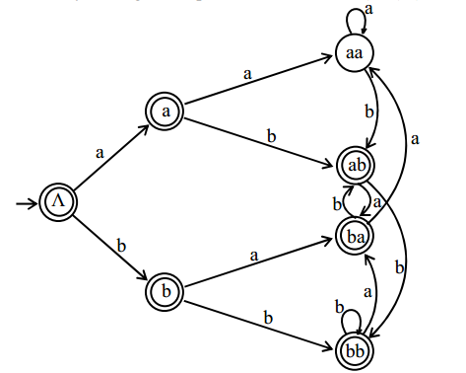

Slide 16
Defining Languages (continued)…
Method 5 (Transition Graph)
Definition: A Transition graph (TG), is a collection of the followings
  Finite number of states, at least one of which is start state and some (maybe none) final states.
  Finite set of input letters (Σ) from which input strings are formed.
  Finite set of transitions that show how to go from one state to another based on reading specified substrings of input letters, possibly even the null string (Λ).

Slide 17
Difference Between FA and TG Methods (v.imp.)
Finite Automata | Transition Graph
Finite number of states, having one initial and some (maybe none) final states. | Finite number of states, at least one of which is start state and some (maybe none) final states.
Finite set of input letters (Σ) from which input strings are formed. | Finite set of input letters (Σ) from which input strings are formed.
Finite set of transitions i.e. for each state and for each input letter there is a transition showing how to move from one state to another | Finite set of transitions that show how to go from one state to another based on reading specified substrings of input letters, possibly even the null string (Λ).
Every FA is a TG as well | TG may not be an FA
In Finite Automata transitions are marked with single letter of alphabet | In Transition Graph, they can be marked with letters or strings (combined of letters)
Continued…

Slide 18
Difference Between FA and TG Methods (v.imp.)
Finite Automata | Transition Graph
In a standard Finite Automaton (FA), you typically do not explicitly visualize or represent epsilon (λ) transitions in the state transitions. In other words, a state acting as the initial and final state can be considered as accepting epsilon. | In a Transition Graph (TG), you can explicitly represent epsilon (λ) transitions, which are transitions that occur without consuming any input symbol
In FA states transition are shown for all letters of given alphabet | In TG, it does not necessarily shows transitions for all letters and even represents multiple paths of each letters.
Strings transitions cannot be showed with FA | String transitions can be showed with TGs

Slide 19
For Example
Consider the language L of strings, defined over Σ={a, b}, having double a or double b.
The language L can be expressed by RE (a+b)* (aa + bb) (a+b)*.
FA and TG would be

Slide 20
FA
x
a
a
a,b
a,b
––
+
b
b
y

Slide 21
TG
x
a
a
a,b
a,b
––
+
b
b
OR
y

Slide 22
TG
a,b
a,b
-
aa,bb
+
OR

Slide 23
TG
a,b
a,b
aa
1-
2+
a,b
a,b
bb
3-
4+

Slide 24
Summing up …
EVEN EVEN,FA corresponding to finite languages(using both methods), Transition graphs.

